Slide 1
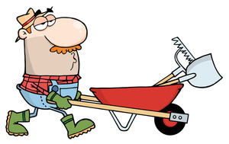
The Super Scooper: Self Scooping Wheelbarrow
By:
Justin Jefferies
8-2

Slide 2
My invention will allow easy loading of materials into a wheelbarrow with just a simple mechanical movement. This invention will help those who commonly lift heavily loads or who suffer from muscle pains. With an easy to use scoop, it will be easier than ever to scoop your materials into your wheelbarrow with ease!

Slide 3
Background Research
For my research, I chose to cite many web sites that include information about shovels, wheelbarrows, heavy machinery, and more. All of the information I have cited will help me in the construction of my invention and give me inspiration for a design that will accomplish my goals. I will use information about the wheelbarrow and its specifications to determine how large the scoop can be, without being too small or too large to fit the front of the wheelbarrow. The information for the sizes of shovels will help because I will most likely mount a shovel to the front end of my wheelbarrow to act as the device to lift dirt into the wheelbarrow.

Slide 4
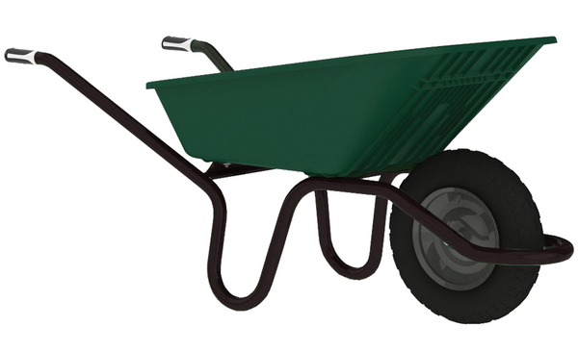
Design Goals
For my invention, I intend to build a wheelbarrow scoop or shovel that will easily load materials into a wheelbarrow. This action will be achieved with a frontal mounted scoop. The ability to easily load a wheelbarrow will be a major advantage to those who suffer from weak joints, back pain, and other detriments to their ability to use a traditional wheelbarrow. Having an easy to operate scoop will also shorten work times and will make work with this tool more efficient than ever before.

Slide 5
Prototype Version 1
Lego Scoop
Lego Wheels
Home made Lego scoop
Lego Beams
Various assorted lego pieces
Prototype Version 2
Wheelbarrow (2)
Brackets
1x2 lumber (2)
Bolts
Washers
Screws

Slide 6
Design Process (Version 1)
My first design is a Lego scoop with a set of wheels attached to the bottom. It also includes two arms mounted on the side which allow easy movement of the front mounted scoop. It includes a stand on the back to keep it from falling down and a handle on the back to push it with. It seems to work well as a small design but will need to be changed to accommodate a full size model.

Slide 7
Design Process (Version 2) Final Design
Assemble wheelbarrow
Take measurements to determine where to attach the scoop
Cut the mounting brackets to size (1x2 lumber)
Cut spacers to shim the mounting brackets
Attach spacers to mounting brackets with wood glue
Drill holes through mounting brackets and wheelbarrow

Slide 8
Design Process (continued)
Attach mounting brackets using 5/16” x 3” bolts
Attached scoop handles using 5/16” x 5” bolts, also using two 1.5”washers on each side to act as spacers
Fabricated the scoop by cutting a wheelbarrow bucket using a pneumatic cut off saw
Did finishing work along all rough edges using a pneumatic burring tool
Cut a mounting bracket used to attach the bucket to the arms

Slide 9
Design Process (continued)
Cut the bracket out of 1.5” x 2” timber
Mounted the bucket to the mount using 5/16” x 2” bolts
Attached the bucket mount to the arms

Slide 10
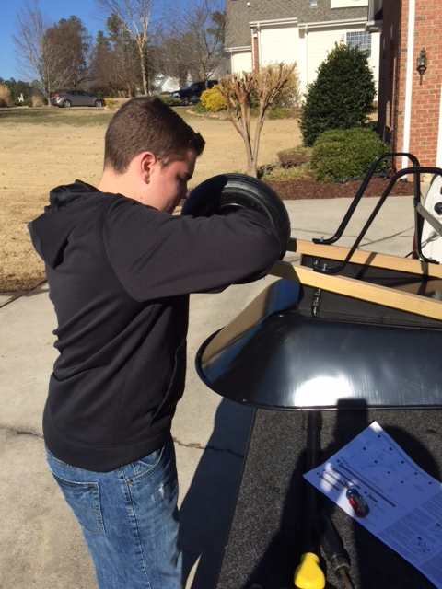
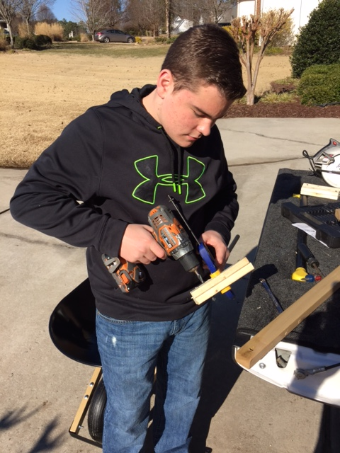
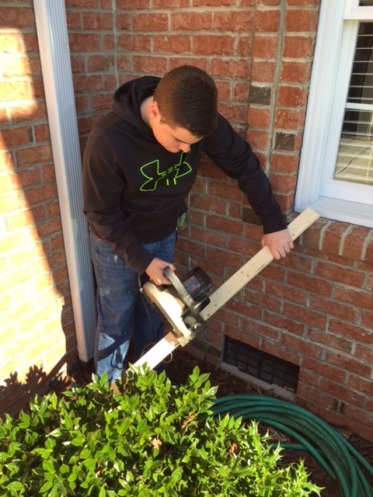
Design Pictures

Slide 11
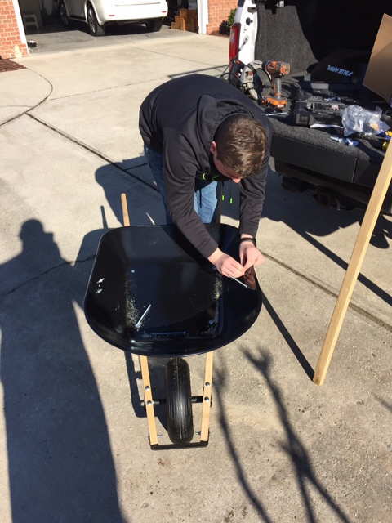
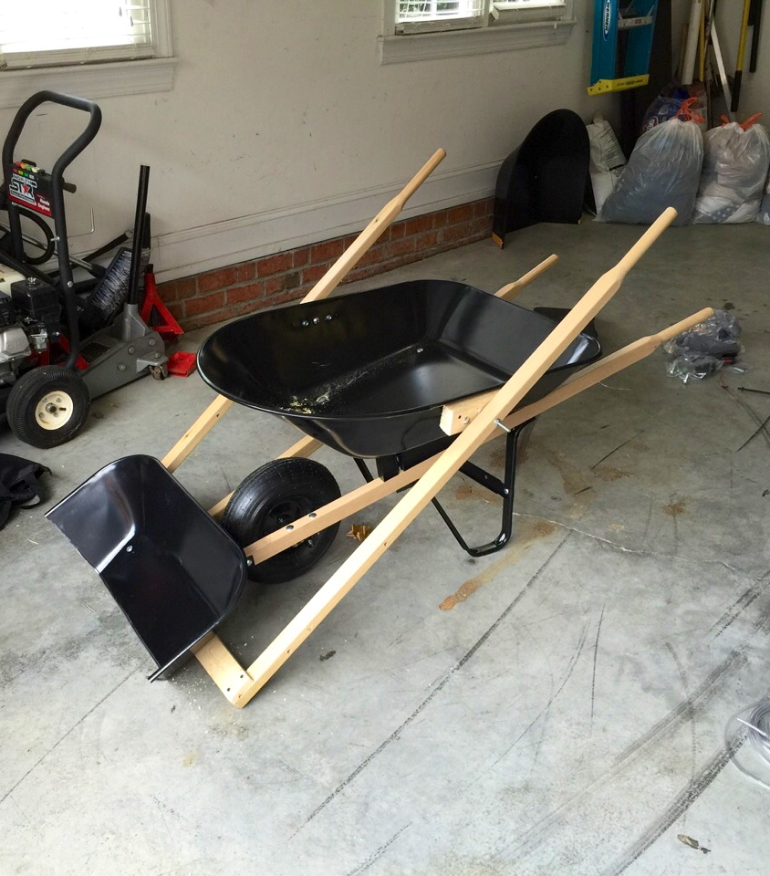
Design Pictures

Slide 12
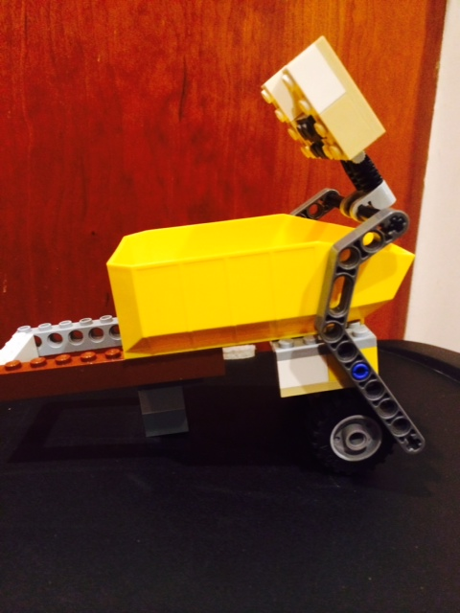
Evaluation of Prototype (Version 1)
My first iteration of my prototype was a small model made out of Legos which represents what I would like my final product to resemble. It has a front mounted bucket held on with two arms which move the bucket up and down to lift materials off of the ground and into the bucket. The arms are rather weak and fall off when too much weight is applied. The model also has a set of wheels under the front section of the wheelbarrow itself and has a stand on the back to keep it from falling over. The front scoop is not slanted which makes loading materials into the bucket a challenge. This will be solved in the actual sized model with the addition of a slanted shovel for a scoop, compared to a near vertical plate.

Slide 13
Evaluation of Prototype (Version 2)
My second and final prototype is made up of a regular wheelbarrow with two handles mounted on each side. I spent approximately $84.00 in materials to complete my prototype. There is a spacer in between the wheelbarrow and the handles to allow easy movement of the scoop. The scoop is mounted in between the two arms. The scoop is made of a smaller wheelbarrow, which was cut in half to allow materials to be pushed into it and loaded into the wheelbarrow with one easy movement.
I feel as though my design works extremely well. I feel it would work better if the arms or handles were articulated so you wouldn’t have to bend over so far to reach the handles. I also think the shovel could have some ridges to catch material more easily.

Slide 14
Feedback From Target Audience
For my target audience, I first chose my father. He used the wheelbarrow and said that it worked extremely well and made shoveling materials easier than ever before. He also noted that has made working with a wheelbarrow more efficient and faster, therefore allowing work times to decrease and give him more time for other activities.
I also chose to ask my neighbor, Patrick, as he works in his yard quite often and thought he could give me feedback that would assist in my project. Patrick thought my idea was extremely inventive and he thought that this would definitely help him when doing yard work. He felt it would especially cut down on work time when shoveling leaves or mulch.

Slide 15
As I began my project, I was hopeful that my invention would be a success. After I built my invention, I tested it and found that it needs to swing back farther to make dumping materials into the hopper easier. It would also help to make the handles articulate, as with their current design you have to bend down to the ground to dump your materials. Overall, my invention completes the job with ease, even with its minor flaws.

