Slide 1
How Colors Change Our Perception of Food?
By: Gavin Hartman / Due: 1- -14 / Class: 8-3

Slide 2
Background Research
Our taste and appetite is most often affected by our sense of sight because we can determine how the food looks before we eat it. Sight is mostly dependent on colors to judge how the food will taste and how appetizing it will be before being eaten. Colors can effect someones appetite whether it is the color of the food or the colors of the room you are eating in. Usually colors like blue and purple are the least appetizing, they are also actually appetite suppressents. They are appetite suppressents because there are not many foods that are blue and purple. However, the most appetizing colors are red, orange, and yellow. These colors help the appetite because they represent feelings of excitment and joy. Green foods are automatically seen as healthy, and safe because of the colors' association with nature. Experiments were done on people in 1970 to see if color really affects appetite. The outcome was that when the steak and french fries turned blue and green while eating the subjects lost their appetite and became ill.

Slide 3
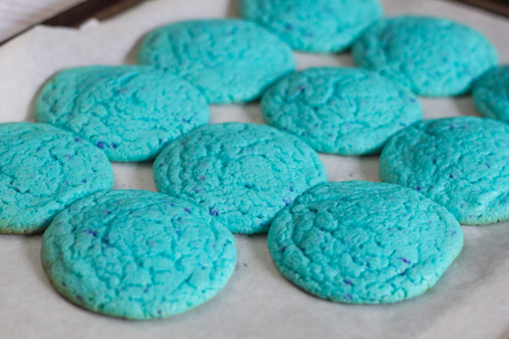
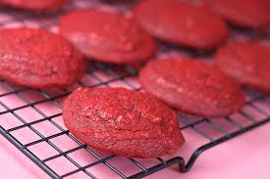
Hypothesis
If a dye a batch of cookies red and blue, then most people will prefer the red cookies because the color blue is an appetite suppressant.

Slide 4
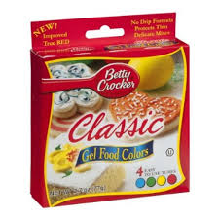
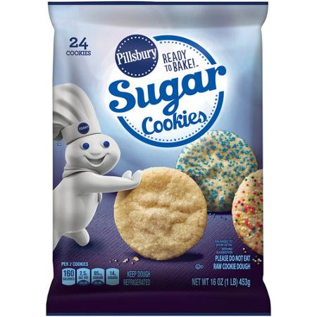
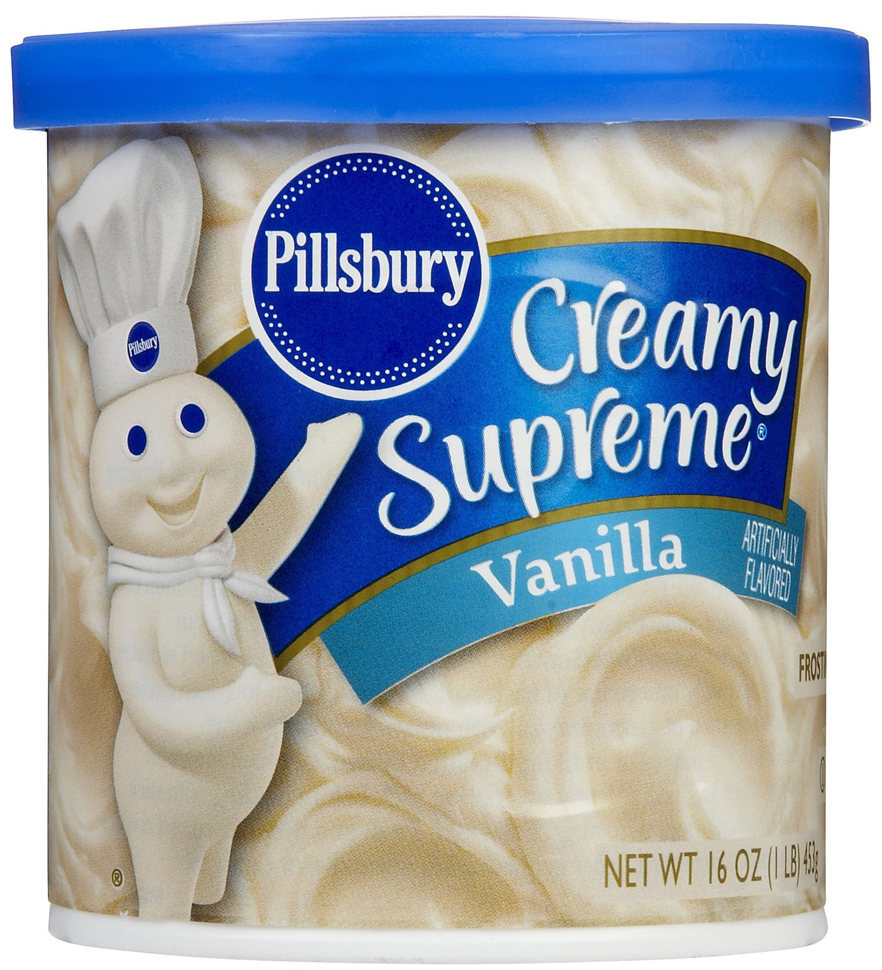
Materials
2 Pillsbury 16oz cups of frosting
4 Ready To Go Pillsbury sugar cookie packs (24 cookies per pack)
1 Red and Blue Crocker food coloring pack
2 bowls
Aluminum Foil
4 platers

Slide 5
Procedure
Roll the cookie dough out into cookie shaped balls.
Take 2 bowls and dump one cup of frosting into each.
Pour all of the red dye into one bowl and blue into the other.
Mix until all of the frosting is solid blue/red.
Cook cookie dough in the oven on 350 degrees for 14 min per two packs of cookies
Spread red frosting on half of the cookies and blue on the other
Put all of the cookies on the four plates
Cover the platers in aluminu foil
Bring to class and record how many picked red vs. the blue cookies

Slide 6
Data
Class 8-1 | Class 8-2 | Class 8-3 | Class 5-3
6 | 7 | 5 | 9
9 | 10 | 9 | 8
Total
27
36
Red
Blue
8-1 is what people perfered after they ate the cookie.

Slide 7
Analysis

Slide 8
Conclusion
My data did not support my hypothesis because the outcome of my data was the opposite of what originally guessed. I thought that the color red would be a more appetizing color than blue because it is an appetite suppressant. However, the outcome of the experiment proved that more people thought the blue cookies were more appetizing than the red.

Slide 9
Applications and Further Explorations
In real life situations my experiment would be a huge help for deciding what food to cook at an outing, party, etc.. My type of experiment would not only be helpful for food, but also for deciding over which object seems the best for everyone. This experiment would require the subject to look at the object test out the object then finally decide which object is better overall.

