Slide 1
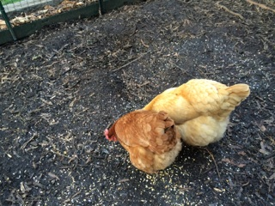
Rainbow Rays and Enormous Eggs
By: Caroline Konrad
Science 8-1

Slide 2
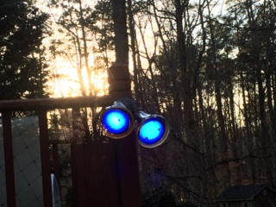
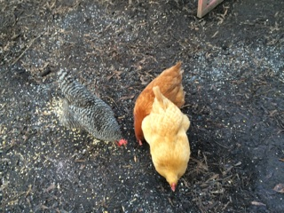
Question
The color red supposedly has the highest effect on a hen's egg laying process, but how do other colors of light compare to the red, and does the color affect the weight of the egg?

Slide 3
Background Research
A hen's egg production rate fluctuates depending on the environment it is in and exposed to. While the color of light does affect the quality of the eggs produced, I am trying to find whether it affects how many eggs are produced in a week. The red light caused the eggs to be the smallest. Although the red light causes the highest production, the other colors have not been tested to see how they compare to the red. The wavelength of the light does affect the production rate, and the color red, I found, has the longest wavelength of the colors of visible light. Many sources say that red has the highest affect on egg production rate, but other colors may be able to compare to the red.
During my experiment, many factors will need to be kept constant. The three hens will be given a certain amount of grit and oyster shells. Grit helps their stomachs to absorb the nutrients from their food. The oyster shells keep their eggshells strong, but they also help to maximize the production rate. Keeping their water full all the time will also help them be the best layers they can be. To optimize the egg production, they will need at least 14 hours of daylight, which will be supplemented by lights. In order to turn the generic lights to other colors, I will need lighting gels. When I use the lighting gels, I will need to make sure that they do not touch the light, for if they touch it, they might melt. The experiment will need to be consistent for all of the colors I use.

Slide 4
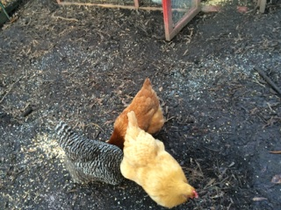
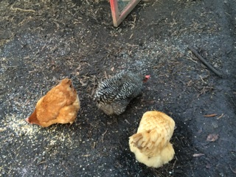
Hypothesis
If the yellow light is used, then the egg production will be the highest because yellow is closest to the color of the sun, and it has the longest wavelength beside red. If the blue light is used, then the weight of the eggs will be the heaviest because the red light, the longest wavelength, causes the smallest eggs, so the blue light, the shortest wavelength, will cause the largest eggs.

Slide 5
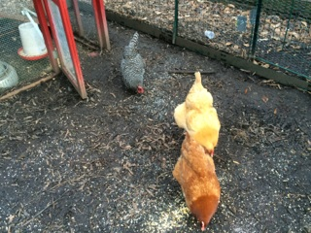
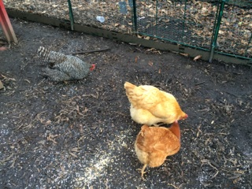
Materials
1 Plymouth Barred Rock Hen
1 Buff Orpington Hen
1 New Hampshire Red Hen
17.5 cups of Chicken Grit
17.5 cups of Oyster Shells
Unlimited Water
50 pound bag of layer feed (pellets)
Food Scale (g)
Equipment for putting up spotlights
4 Lightbulbs
Electrical Things for wiring lights
Timer for the lights
16 Lighting Gels (4 red, 4 blue, 4 yellow, 4 green)
Chicken habitat and supplies
5 weeks for testing purposes
Clear Packaging Tape

Slide 6
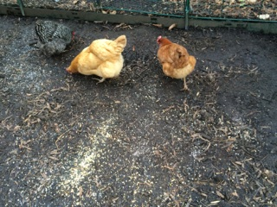
Procedure
You will need to have three egg laying hens.
Buy and set up four lights around the coop in groups of two.
The lights will need to be programmed to come on for 14 hours each day.
Each morning, one half cup of grit and one half cup of oyster shells will need to be sprinkled around the coop.
Make sure that the chickens have plenty of food and water for the day.
Eggs will need to be collected and charted each day of the experiment.
After you collect an egg, weigh it on the food scale and record in grams.
Record the weight on a table containing the day and number of eggs collected.
At the end of each 7 day week, compute the average of the weight of the eggs and the number of eggs collected.
The lighting gels on the lights will need to be changed at the beginning of each new week.
In the first week, no lighting gels will be used. The lights themselves will be used as a control group.
On week 2, one of the lighting gel sets will be used on the lights.
To attach the lighting gels, you will need to put a piece of packaging tape over the light gel and tape it over the light using the packaging tape.
Continue collecting data throughout the five week experiment, changing the light color every week.
Put all the data into graphs by average weight of eggs and average number of eggs, comparing the weeks, and analyze them to find the results of your experiment.
 | Sunday | Monday | Tuesday | Wednesday | Thursday | Friday | Saturday
Egg 1
Egg 2
Egg 3

Slide 7
Data
BLUE | Thursday | Friday | Saturday | Sunday | Monday | Tuesday | Wednesday
Egg 1 | 60 g | 63 g | 53 g |  | 62 g | 59 g
Egg 2 | 55 g | 56 g | 53 g |  | 61 g | 60 g
Egg 3 |  |  | 56 g
YELLOW | Thursday | Friday | Saturday | Sunday | Monday | Tuesday | Wednesday
Egg 1 | 59 g | 57 g | 62 g | 55 g | 58 g | 62 g | 59 g
Egg 2 | 56 g | 55 g | 59 g | 53 g | 59 g |  | 58 g
Egg 3
GREEN | Thursday | Friday | Saturday | Sunday | Monday | Tuesday | Wednesday
Egg 1 | 59 g | 61 g | 56 g | 58 g | 63 g | 59 g | 62 g
Egg 2 |  |  |  |  | 56 g
Egg 3

Slide 8
Data, Continued
RED | Thursday | Friday | Saturday | Sunday | Monday | Tuesday | Wednesday
Egg 1 | 53 g | 58 g | 56 g | 59 g | 58 g | 61 g | 63 g
Egg 2 | 56 g | 62 g |  | 58 g |  |  | 58 g
Egg 3
WHITE | Thursday | Friday | Saturday | Sunday | Monday | Tuesday | Wednesday
Egg 1 | 62 g | 57 g |  | 61 g | 58 g | 59 g | 56 g
Egg 2 | 58 g | 55 g |  | 57 g | 57 g | 54 g
Egg 3 | 55 g

Slide 9
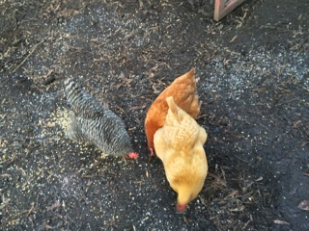
Analysis

Slide 10
Conclusion
In conclusion, my hypothesis was completely incorrect. While I thought that the yellow light would produce the greatest number of eggs, the white light yielded the highest number of eggs. Although, the red light did not have the highest number of eggs as it was previously thought. White, with the average number of eggs per day at 1.9 eggs, beat out the competition by at least 0.1 eggs per day. The lowest number of eggs per day was the green with 1.1 eggs per day. Both the red and blue lights had 1.6 eggs per day. The yellow light had the second highest number of eggs at 1.8 eggs per day. The white light produced the highest number of eggs per day.
The other half of my experiment was the weight of the eggs. I predicted that the blue light would have the largest eggs because a former experiment showed that the red eggs were the smallest. The green light actually yielded the largest eggs at 59.3 grams. The smallest eggs came from the white light at 57.1 grams. Red had the second largest eggs at 58.4 grams. The green light caused the largest eggs out of the five colors tested.

Slide 11
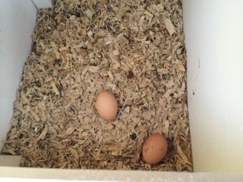
Applications and Further Explorations
This experiment helped to reveal how color affects, or doesn’t affect, a hen’s laying process. This could apply to the “real world” in several ways. If someone owns an egg producing factory, they would want to put out the yellow light color in their factory to have the hens produce as many eggs as possible to have the highest profit. If they wanted to get the biggest eggs, then they would need to put out the green light. To get these high production rates, the lights have to be on for at least 14 hours each day. The red light should be positioned in factories for the highest and largest egg production rates possible because it had the highest numbers without compromising on one section. Experimentation can help to improve efficiency in the “real world.”
After this experiment, I can conclude that some research that has been done is wrong, in my case. I found that red did not, as previously shown, cause the highest production rate. In fact, the white light showed the highest number of eggs per week compared to the red, yellow, blue, and green lights. When chickens are laying eggs, they have to be stimulated by wavelengths that are strong enough. Even though the red has the longest wavelength, it did not cause the largest eggs or the highest amount of eggs. If I could continue experimenting, then I would test all the colors of the rainbow to see how the results vary. I could also test the age of the chickens. The white light caused the highest weight of the eggs, and the green light caused the largest eggs.

