Slide 1
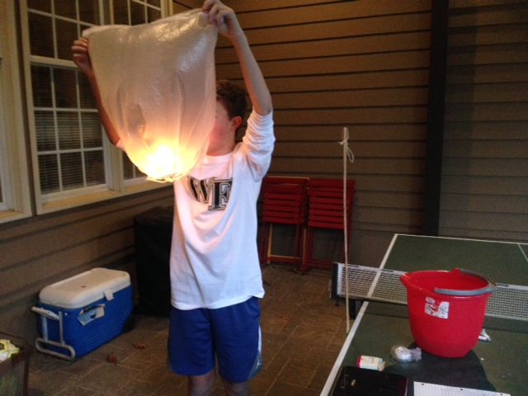
Flying Lantern Models
by: Rob Treadway

Slide 2
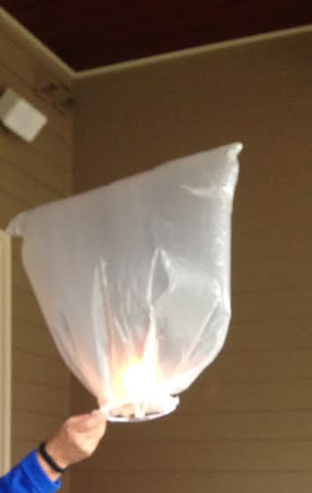
Product Goal
My original goal for this project was to get the lantern to fly however I had to change that goal when I learned I couldn’t get it to fly. My new product goal is to find out which lantern prototype is closest to flying. In order to figure that out, I will drop the prototypes from the same height and whichever prototypes falls to the ground the slowest is the closest to flying.
Notes:
Wasn’t the actual goal to get one that flies?

Slide 3
Background Research
Hot air balloons and flying lanterns are very similar.
Hot air balloons fly with flames coming from the gas burner and heating up the balloon.
Flying lanterns use candles to heat up the lantern
It flies because the warm air heats up the lantern. Since the warm air is less dense than the air outside, the lantern rises.
A flying lantern should only be flown in an open area, with little to no wind, and with a tether connected to it at all times.
Flying lanterns can be made with different ways: a paper bag, tissue paper, trash bag, or construction paper.
In Raleigh, flying lanterns are legal because they’re not fireworks.
Citations
<https://aditiodyssey.wordpress.com/2012/11/12/how-to-make-sky-lanterns/>.
<http://mad-science.wonderhowto.com/how-to/elementary-sputnik-satellites-make-trash-bag-hot-air-balloons-0133906/>.
<http://www.boeing.com/companyoffices/aboutus/wonder_of_flight/balloon_colored.html>.
<http://www.msichicago.org/online-science/activities/activity-detail/activities/fly-a-hot-air-balloon/browseactivities/9/>.
<http://www.skylanternsonline.co.uk/instructions-for-use/>.
<http://books.google.com/books?id=BxdQAAAAYAAJ&pg=PA12&lpg=PA12&dq=raleigh+regulations+on+lanterns&source=bl&ots=00G6IiNy9Y&sig=sWOX-X_ReMLYUUH0EESnNMwBNM0&hl=en&sa=X&ei=tBxyVO6wFYaYgwS_sITwDg&ved=0CGMQ6AEwCQ#v=onepage&q=raleigh%20regulations%20on%20lanterns&f=false>.

Slide 4
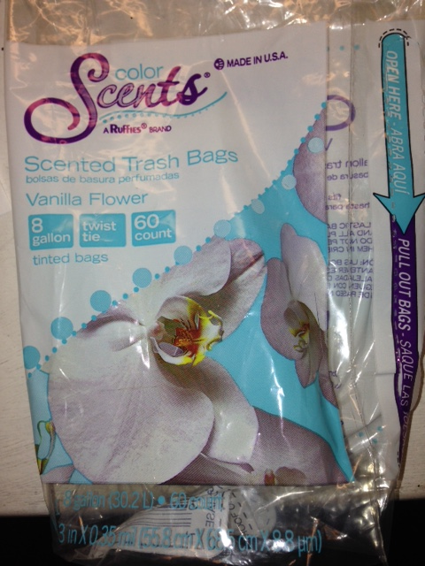
Materials
72 birthday candles
floral wire (22 gauge)
4 straws
3 garbage bags: volume of 8 gallons, 0.3 mm in thickness
Scotch tape
stopwatch/phone
yard stick/meter stick
bucket of water
lighter
thermometer
small scale
scissors
another person to help
Notes:
mL is a unit of volume. Did you mean mm?

Slide 5
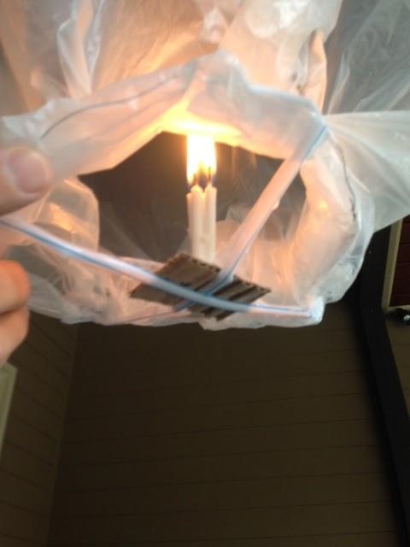
Design Process
Final/Most Successful model
Make a 20 in. ring out of floral wire to serve as the lantern’s base.
Tape 4 sides of the ring to the bottom of the trash bag; fold over the left over trash bag and tape it down.
Cut 1 straw in half, then tape it the ring of wire, make sure to tape it as an x.
Melt the bottoms of 4 candles and attach them to a 3 by 3 in. square of aluminum foil.
Tape the candles on aluminum foil to the middle of where the straws cross.
Take the lantern outside and head to an open area.
Next, have a helper hold the lantern as you prepare to light it.
Slowly bring the lighter inside the balloon and light all the candles.
Notes:
Add a little info about the light and launch process.

Slide 6
Evaluation of Prototypes
Evaluation of Prototypes
Paper bag- The bag is heavy with only a small amount of candles, but its small volume causes it not to fly.
Large 12 gal. trash bag- This next model I tried with 4 candles but it wouldn’t fill the bag.
Large 12 gal. trash bag- I then tried to use 8 candles but it didn’t do much.
Large 12 gal. trash bag- Instead of 4 & 8 candles I used 12 and it was still heavy.
Small 8 gal. trash bag- This is the perfect size with 8 candles.

Slide 7
Evaluation of Prototypes- Observations
Observations seen throughout- final model (8 gallon bag)
 | 4 Candles | 8 Candles | 12 Candles
Observations | very light, needs more lift to heat bag | seemed to be the right amount of candles, | began to melt the lantern after first trial; very warm air inside the lantern; small amount of condensation seen on the lantern
Notes:
Are these with the 8 or 12 gallon bag?

Slide 8
Evaluation of Prototypes- Data
DataTable (8 gallon bag)
 | 4 Candles | 8 Candles | 12 Candles
Temperature (degrees Fahrenheit) | 54 | 54 | 52
Average Weight (g) | 12.5 | 15 | 20
Burning time (sec.) | 120 | 120 | 120
Drop Height (ft.) | 5 | 5 | 5
Average Drop time (lit) | 2.04 | 2.11 | 1.5
Average Drop time (not lit) | 1.48 | 1.2 | 0.95

Slide 9
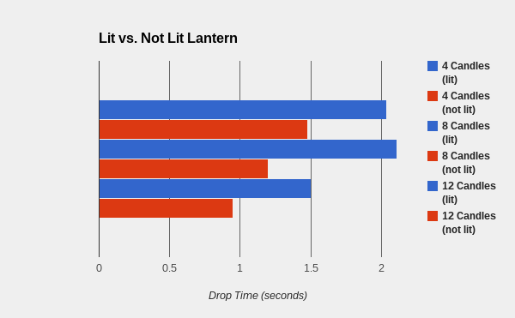
Evaluation of Prototypes- Graphs
Graphs from throughout- final model (8 gallon bag)
Notes:
A graph that has those drop times side by side so that you could see the increase would make your point better.

Slide 10
Conclusion
Originally my project goal was to make a lantern fly. I tried several different models trying to get them to fly, but they never actually flew. On some the weight was too much, on others the candles burnt the bag, and some other ones just couldn’t quite get hot enough. Based on that, my original project failed to come close to my goal. The most difficult part about that was knowing that it was never going to fly, so I had to create a new goal.
My new goal wasn’t to get it to fly, but it was instead to see which amount of candles with the final model was closest to flying. I tested my final model of an 8 gal. trash bag with different amounts of candles. I dropped each bag with a different amount of candles from a height of 5 ft. Also before I dropped each lantern, it had to heat up for 2 minutes to insure that the lantern was hot enough. Trash bags seemed like the lightest item with the most volume that could be found in stores.
Overall I am proud of my project, but disappointed that I couldn’t get any lanterns to fly. The only reason I could think of as for them not flying is the weight of the lantern and the amount of volume. Throughout my first goal I tweaked the volume and amount of lift several times but neither time could I get it to work. If I were to try this again, I might use a different model that is lighter and with a different source of fuel. The difference between it flying and not flying may only be a slight amount, yet it’s hard to ever tell.
Notes:
nice job on this slide

