Slide 1
Individual Science project
Elizabeth riddick

Slide 2
Question: Does the best way of learning and memorizing information change for each gender, and which is the best way for each gender to learn information?

Slide 3
Background research: While researching, I found out that girls usually do better in the classroom and on average they make better grades than boys. I also found out that boys and girls do learn differently so hopefully with my results I will be able to see a difference. I also looked at a previous experiment conducted by a college to see what the students did inside a computer lab. It said that most people were not studying, but there were more girls taking it seriously than the boys in the lab. This source also gave me another way to test people since I hadn’t thought of giving information to people on a computer. On another website, I found out that highlighting, rereading, and other common ways of studying were not the best way to learn information. They said that the best way to study is to spread it out over time so you can learn the information rather than studying last minute just so you can memorize the information before a test. While doing my research I also found out that there are three different ways of learning which include auditory, visual, and kinesthetic learning. Visual learners are better with pictures and graphs while auditory learners learn information through speaking, and kinesthetic learners are better when information is shown to them rather than verbally taught.

Slide 4
Hypothesis: If boys and girls learn differently, then the girls will do better with visual or auditory information because that is how information is most commonly taught in school, and the boys will do better while information is given though electronics because they don’t do as well in the classroom, and electronics aren’t the most common way of teaching inside of school.

Slide 5
materials:
Six female eighth grade subjects
Six male eighth grade subjects
One laptop to present information and to use to make a glogster and to be able to create tests

Slide 6
Procedure: 1. for this experiment, you will need an equal number of boys and girls, but the number of members in each gender will need to be divisible by 3 because there are three different ways of presenting information, and for the best results, it would help to have an even number of people For each different section.
2. You will need to come up with information, that can be repeatedly used and put into three different formats without changing it too much. You will also need to come up with ten multiple choice questions having to do with the story that will be used for each group. Do not change the order of the questions for anything.
3 Divide up the twelve people that have been chosen into three groups each with two boys and two girls.
4. For the group that will have to read to themselves, give them the information and time them so they can only read it for two minutes.
5. Give them questions immediately after the read it and let them answer it.
6. The questions will have to be answered again two days later and again one week after they read it.
7. For the group getting read aloud to, they will need to be read aloud to nonstop for two minutes so the story might be repeated. Like the other group they answer questions immediately after, two days after and a week after.
8. For the group with the glogster or online presentation, let them look over it for two minutes and do the same routine with the questions as the other group.
9. The first time that the subjects have read through the information is the only time they can review the information, so the two minutes is all they have. Notes about the information cannot be taken either.
10. Once all test have been completed, take the results and check them all.
11. For each separate gender in each of the groups, average the scores, but separately for each trial so that you will be able to compare the data for each group over the different periods of time.

Slide 7
DATA
BOYS AVERAGE | GLOGSTER | READING ALOUD | READING THEMSELVES
TRIAL 1 | 10 | 5.5 | 9.5
TRIAL 2 | 10 | 5 | 9
TRIAL 3 | 9.5 | 6 | 7.5
GIRLS AVERAGE | GLOGSTER | READING ALOUD | READING THEMSELVES
TRIAL 1 | 7.5 | 9.5 | 10
TRIAL 2 | 8 | 9.5 | 9
TRIAL 3 | 8.5 | 9 | 9

Slide 8
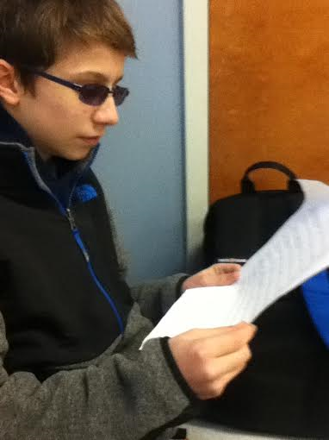
ANALYSIS
For the section of my experiment using the Glogster, overall the boys did better, but their scores decreased later on while the girls score got better with each trial.

Slide 9
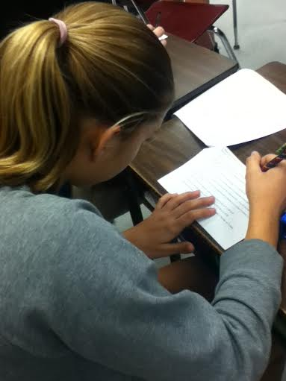
The girls did much better when they were read aloud to than the boys, and the girls maintained a pretty consistent score throughout the trials.

Slide 10
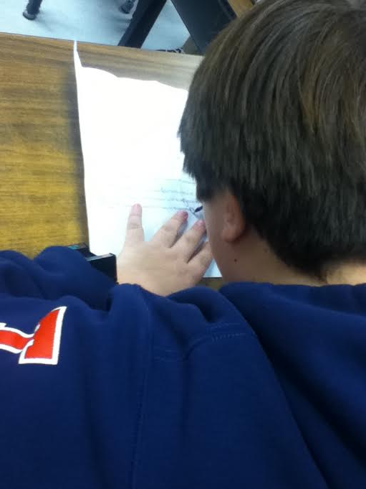
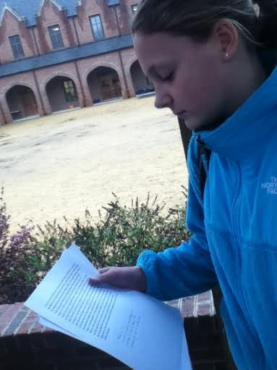
Though the girls and boys got the same score for trial 2, the girls did better than them on the other two trials.

Slide 11
CONCLUSION
In the end, my hypothesis was correct. I thought that the boys would end up doing the best with the Glogster test, which they did, and I thought that the girls would do the best with a visual or auditory test, and they did. If you add up the trial scores for girls, the Glogster gets the lowest score and the reading aloud and reading to themselves groups were tied for the amount of questions answered correctly. For the boys, the lowest scores were when they were read aloud to, then when they read to themselves, and the highest was the Glogster.

Slide 12
Applications and Further explorations
In real life, my experiment could be helpful if a teacher wanted to figure out a way of learning that was good for everyone in their class, but for additional experimentation they could use more people instead of twelve since that is not a normal class size, or they could add another category of learning styles in too. Also it also could be helpful for a company producing learning tool, so they can see if the best way to learn is by making a textbook, going online, or etc.
For further experimentation, I could look at people’s grades and put them in different groups seeing whether skill level changes any of the results, or I could have used even more people for my experiment so that grades would not matter since there would be people from each different skill level. Also the people I read aloud to were outside so I am not sure if noise from being out there would affect them being able to hear the story well and if it did, then their scores might have been lowered due to the fact that they could not remember as much.

