Slide 1
How fast fuses burn
Question: How fast will different types of fuses burn?
Warren Fusco
Sci 8-1

Slide 2
Background Research
Gunpowder is the main ingredient in fuses. In fuses, gunpowder is wrapped tightly with a small string to keep it together. Gunpowder has been used in fuses since ancient Chinese times, and it has been used as an initial charge for explosives and fireworks through the present day¹.
Visco is the most common fuse in the world. Visco is popular because it is cheap and holds together well². Visco fuses will be tested in this study. Another common fuse that is tested in this study is called the Flying Fish fuse. Flying Fish fuses burn fast and burn well. Two other home made fuses will be tested in this study. One home made fuse is made with plain string, and the other is made with string, wax, and ground up match heads.

Slide 3
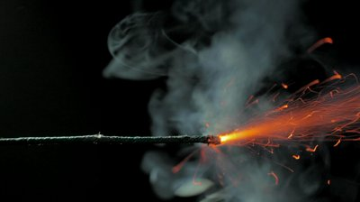
Hypothesis
I expect that the Flying Fish fuse will burn the fastest because it was made by professionals and holds together well. Flying Fish fuses are also very thin and I expect that this would make it burn at a fast rate. If the fuse is thin and tightly wrapped then the fuse will burn faster because it is more compressed and it takes a shorter time for the gunpowder to ignite the other gunpowder in the fuse. The tight wrap will ensure that the fuse stays together and will spread the flame throughout the fuse.

Slide 4
Materials
FUSES and FUSE CONSTRUCTION
Four 1 foot lengths of regular Visco fuse
Four 1 foot lengths of Flying Fish fuse
Four 1 foot lengths of home made string fuse
Home made combustible fuse:
Four 1 foot lengths of string
100 match heads
Candle wax as needed
EXPERIMENT MATERIALS
1 butane fire stick
Two stopwatches
1 camera
1 piece of wood
Screws to hold fuses in place

Slide 5
Procedure: Fuse Construction
FUSE CONSTRUCTION
Cut Flying Fish fuse and Visco fuse into four 1 foot lengths.
Cut regular string fuse into four 1 foot lengths.
Home Made Combustible Fuse:
Cut string into a 4 foot length.
Grind 100 match heads into powder and put into 4 foot line on a piece of waxed paper.
Melt enough wax from a candle to cover the entire length of the string.
Dip entire length of string into melted wax.
Lay the string on top of the ground match heads and roll to ensure that string is covered with the powder.
Let wax cool and solidify.
Cut home made fuse into four 1 foot lengths.

Slide 6
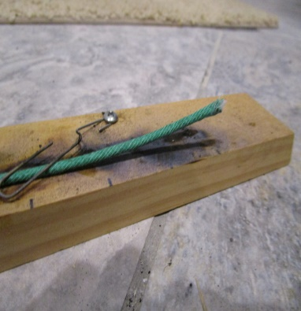
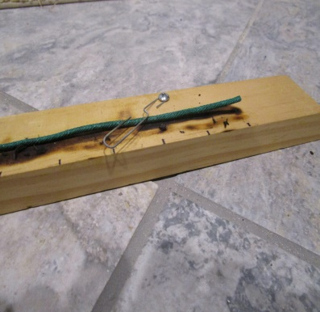
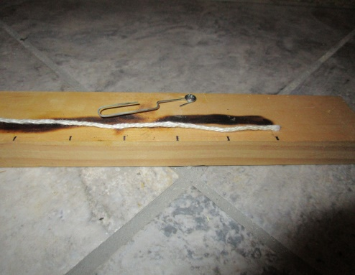
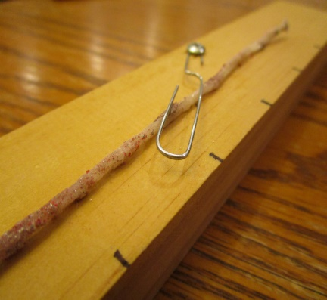
Procedure: Fuse Construction
Flying Fish
Visco
Plain String
Home Made

Slide 7
Procedure: Test process
Experimental Process
Collect all materials and instruments.
Attach one Flying Fish fuse to piece of wood using screws.
Zero stopwatches.
Light fuse while starting stop watches.
Stop one watch at six inch mark.
Stop second watch at complete burn.
Record times.
Repeat steps 2 through 7 for remaining three Flying Fish fuses.
Repeat steps 2 through 8 for remaining three types of fuses.

Slide 8
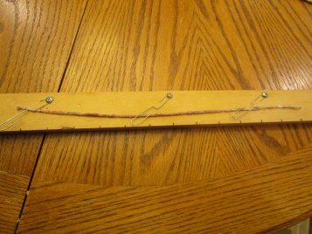
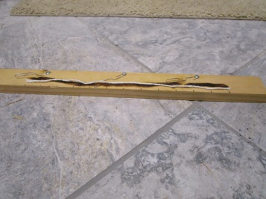
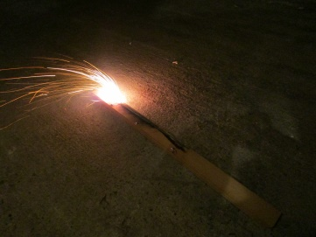
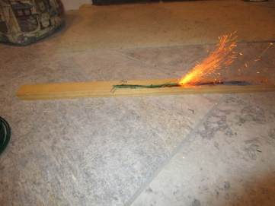
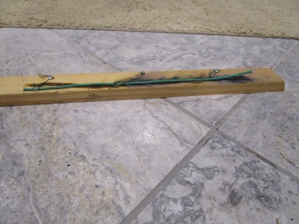
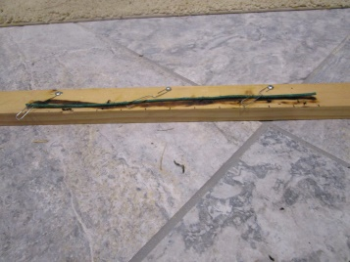
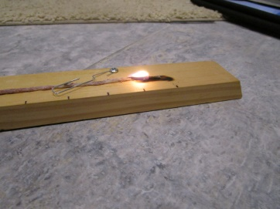
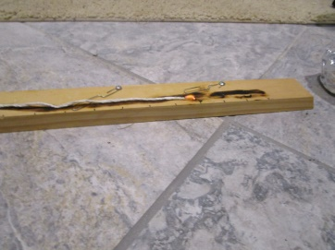
Procedure: test process
Fuse in holder before test
Fuse during test
Home Made fuse
String fuse
Flying Fish fuse
Visco fuse
Flying Fish fuse
Visco fuse
Home Made fuse
String fuse

Slide 9
Data
 | Visco | Flying Fish | String | Home Made
Test 1 | 17 | 22 | N/A | 901
Test 2 | 15 | 20 | N/A | 976
Test 3 | 15 | 21 | N/A | 888
Test 4 | 16 | 20 | N/A | 839
Visco fuse makes lots of sparks and burns at an average rate of 15.75 seconds per fuse
Flying Fish fuse makes purple sparks and burns at an average rate of 20.75 seconds per fuse
String fuse fails to stay lit and never completely burns without being re-lit.
Home made fuse burns slowly but eventually burned completely. Average burn rate was 901 seconds per fuse.
Times in seconds

Slide 10
Analysis
The bar chart below shows the average burn times for each fuse.
The chart shows that the professionally made fuses burned much
quicker than the home made fuses.
Did Not
Completely Burn

Slide 11
Conclusion
The fastest of all the fuses was the Visco fuse. The reason why this fuse was the fastest is because of how tightly packed the gunpowder was in it. My hypothesis that the Flying Fish fuse would burn fastest was wrong, but now I know how efficient each fuse is and their strengths and weaknesses. It is possible that the Visco fuse is faster than the Flying Fish fuse because the Visco fuse was stiffer than the Flying Fish fuse, which could indicate that the gunpowder was more tightly packed in the Visco fuse.
Even though the Flying Fish did not burn as fast, it may be a good choice because it makes different colors and burns at a slower, more controlled rate. Depending on home made fuses is not recommended because they are inconsistent and take a long time to make. These reasons and the low cost of professionally made fuses make them a better choice than home made fuses for home use.

Slide 12
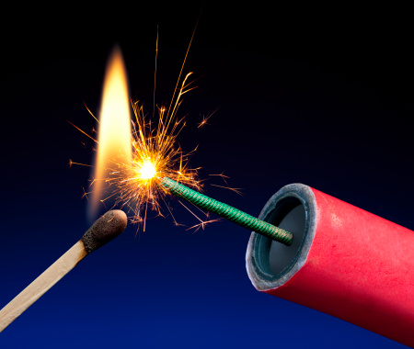
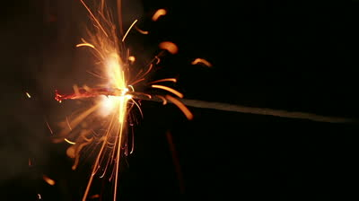
Application and Further explorations
My experiment can be helpful in real life situations because it could determine life or death. If the wrong type of fuse was put on a firework, and the fuse burned too quickly, injury to the user could happen. Knowing accurate fuse burn times can prevent such an event. Similar information would be needed for other uses, like demolition, for example.
The conclusion shows that the tightness of the packing of gunpowder may affect burn times. Future experimentation could measure this packing tightness, and see if it has a measurable impact on burn times.

Slide 13
Citations
Langone, John. National Geographic's How Things Work: Everyday Technology Explained. Washington, D.C.: National Geographic, 1999. Print.
"Visco Fuse." Wikipedia. Wikimedia Foundation, 14 Nov. 2014. Web. 17 Nov. 2014.

