Slide 1
Electronic Reader Versus Hardcopy
By: Evan Bartle 8-1

Slide 2
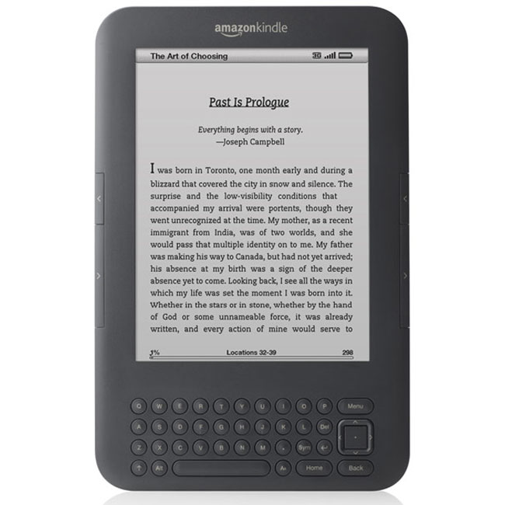
The Question
Do seventh and eighth graders comprehend and retain more information in hardcopy form or in a electronic reader using non-fiction, fiction, and textbook articles/short stories?

Slide 3
Background Research
Since many of the schools in the US are investing substantial amounts of money in digital technology, the National Assessment of Educational Progress did a study on all 50 states and found that the states who adopted new digital technology never did a follow up study on their Return on Investment. In fact, some school districts have found that there has been no measurable improvement in test scores following technology investments. I wondered if there is a difference in comprehension and retention between an e-reader compared to a hardcopy/book amongst my peer group. In my background research, I found that people who have read on an electronic reader cannot remember events that have happened in chronological order. In every short story/article that I test, there will be one question dedicated to testing chronological order. Another surprising part I found out was that people may remember more on a book than a e-reader. In a book, you have the physical reference point of how much you have read where as with the Kindle, that is just slick and smooth, it is hard to tell how much of the book you have left to read. So the “feel” of the book also plays a role in the subject’s memory. In my study, I plan to test comprehension and retention among seventh and eighth graders by having them read either a non-fiction short story, a fiction short story, or a textbook article in an electronic or hardcopy form. After they have read the short story, I will hand them a quiz on the short story/article .

Slide 4
Hypothesis
If subjects are presented information in a hardcopy format, then their comprehension will be better because of the visual and tactile “feel” of the short stories.

Slide 5
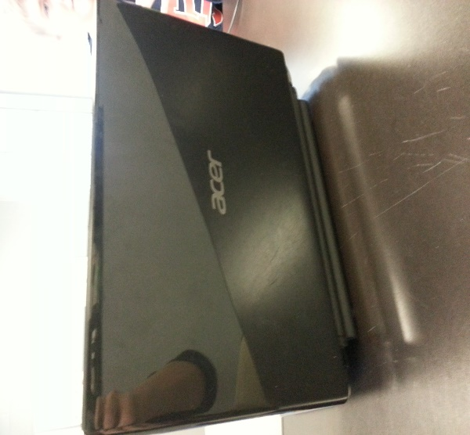
Materials
5-8 Acer laptops
2 short stories( one fiction one non-fiction)
3 different sets of quizzes for each individual genre of short story( subjects reading fiction will need a fiction quiz) Make sure all of the quizzes are made to test comprehension and retention. Also make sure that all of the quizzes are at an appropriate reading level for the grade.
Microsoft Excel to analyze the data
90 subjects
1 textbook article( My textbook article came from Digital History, I find Digital History reliable because we have often used it in our History class.)
2 Teachers to aid in data collection

Slide 6
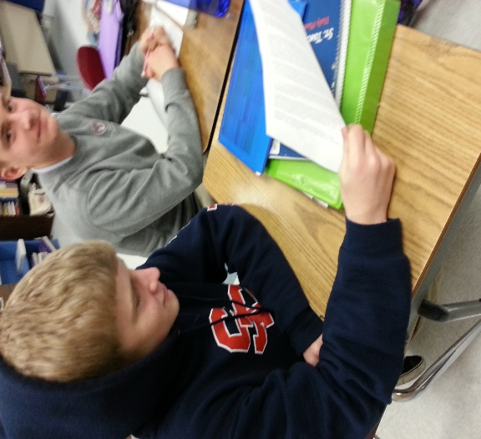
Procedure
Find 2 short stories and 1 textbook article off the web, and make sure that they don’t have any advertisements on them. If you’re lucky, there might already be questions for a quiz on the website. If not, then you’ll have to make your own questions. Print hardcopy form of the short stories and put electronic versions of short stories in class Weebly page(In Microsoft Word format). Prepare test materials for teachers( e.g. quizzes and the individual short stories)
2. Hand the short stories and the quizzes to either Mrs. Sanders (if it’s a eighth grade class you are testing) or Mrs. Iiames (if it’s a seventh grade class you are testing.)
3 Have the teachers order half of the students to grab laptops. Have the students who were elected to get a laptop open up to the class Weebly page.
4.Once the e-reader students have pulled the story up on the Weebly page, hand out the hardcopy version to the rest of the class who don’t have a laptop. When everybody in the class has the story either on hardcopy form or e-reader, order them to begin to read it.
5.When the student is finished reading the story tell them to either shut the top of the laptop, or hand their hardcopy form back to the teacher. Hand the students the quiz when they have done that.
6. Once they have finished the quiz, have them hand it into the teacher so you can mark whether it’s a boy/girl, grade level 7/8, and electronic/hardcopy.
7. After you have all the classes quizzes, give them a grade out of 7( e.g.. If they missed one it would be a 6/7.) When you have finished grading all of the tests, input all of the data into Microsoft Excel

Slide 7
Data
Count of subject | Column Labels
Row Labels | Electronic | Paper | Grand Total
Fiction | 17 | 15 | 32
7 | 9 | 9 | 18
F | 5 | 1 | 6
M | 4 | 8 | 12
8 | 8 | 6 | 14
F | 3 | 3 | 6
M | 5 | 3 | 8
Non-Fiction | 14 | 13 | 27
7 | 8 | 7 | 15
F | 3 | 3 | 6
M | 5 | 4 | 9
8 | 6 | 6 | 12
F | 4 | 4 | 8
M | 2 | 2 | 4
Text | 16 | 15 | 31
7 | 8 | 8 | 16
F | 4 | 4 | 8
M | 4 | 4 | 8
8 | 8 | 7 | 15
F | 5 | 5 | 10
M | 3 | 2 | 5
Grand Total | 47 | 43 | 90
90 subjects participated in my study. 47 of them read off of an electronic reader while 43 read in hardcopy form. All of my test subjects attend St. Timothy’s School, and they are all from 7th and 8th grade. Also, all of the subjects were randomly chosen by the teachers, and they tried to mix the genders evenly for electronic/hardcopy.

Slide 8
Analysis - Averages
Average Correct Score | Column Labels
Row Labels | Electronic | Hard Copy | Grand Total
Fiction | 1.82 | 2.53 | 2.16
Non-Fiction | 3.43 | 4.77 | 4.07
Text | 5.31 | 5.40 | 5.35
Grand Total | 3.49 | 4.21 | 3.83
Regardless of genre, subjects’ comprehension was highest for the hard copy format vs electronic. On average, scores for the hard copy method were 20% higher.
Regardless of format (electronic vs hard copy) subjects scored highest on the textbook, then non-fiction formats.
genre
format

Slide 9
Analysis – Averages (Interactions)
Average Correct Score | Column Labels
Row Labels | Electronic | Hard Copy | Grand Total
Fiction | 1.82 | 2.53 | 2.16
Non-Fiction | 3.43 | 4.77 | 4.07
Text | 5.31 | 5.40 | 5.35
Grand Total | 3.49 | 4.21 | 3.83
When we look at both format and genre, subjects scored highest on hardcopy/textbook and lowest on fiction/electronic. On average, scores for the hard copy/textbook were 197% higher than fiction/electronic.

Slide 10
Analysis-Variation
Var of Total | Column Labels
Row Labels | Electronic | Hard Copy | Grand Total
Fiction | 1.40 | 1.84 | 1.68
Non-Fiction | 2.26 | 2.03 | 2.53
Text | 0.63 | 0.69 | 0.64
Grand Total | 3.52 | 3.03 | 3.38
Regardless of genre, subjects’ variation in comprehension was highest for electronic vs hard copy method. On average, scores for the electronic reader had 16% higher variation.
Regardless of format (electronic vs hard copy) subjects’ variation for non-fiction was the highest.

Slide 11
Data – Variation (Interactions)
Var of Total | Column Labels
Row Labels | Electronic | Hard Copy | Grand Total
Fiction | 1.40 | 1.84 | 1.68
Non-Fiction | 2.26 | 2.03 | 2.53
Text | 0.63 | 0.69 | 0.64
Grand Total | 3.52 | 3.03 | 3.38
When we look at both format and genre, subjects’ variation was highest on non-fiction/electronic.
Interestingly, the lowest variation was electronic/textbook. This may be due to the fact that the quiz for the textbook was designed by the experimenter whereas the other quizzes were primarily designed by teaching professionals.

Slide 12
Analysis

Slide 13
Analysis

Slide 14
Analysis - Gender
Average Correct Score | Column Labels
Row Labels | Electronic | Hard Copy | Grand Total
Fiction | 1.82 | 2.53 | 2.16
F | 2.13 | 2.75 | 2.33
M | 1.56 | 2.45 | 2.05
Non-Fiction | 3.43 | 4.77 | 4.07
F | 3.57 | 5.14 | 4.36
M | 3.29 | 4.33 | 3.77
Text | 5.31 | 5.40 | 5.35
F | 5.56 | 5.22 | 5.39
M | 5.00 | 5.67 | 5.31
Grand Total | 3.49 | 4.21 | 3.83
I also observed that females tended to do better on all formats and genres except for the hardcopy textbook where the males were higher.
Average Correct Score | Column Labels
 | Electronic |  | Electronic Total | Hard Copy |  | Hard Copy Total | Grand Total
Row Labels | F | M |  | F | M
Fiction | 2.13 | 1.56 | 1.82 | 2.75 | 2.45 | 2.53 | 2.16
Non-Fiction | 3.57 | 3.29 | 3.43 | 5.14 | 4.33 | 4.77 | 4.07
Text | 5.56 | 5.00 | 5.31 | 5.22 | 5.67 | 5.40 | 5.35
Grand Total | 3.83 | 3.13 | 3.49 | 4.70 | 3.78 | 4.21 | 3.83

Slide 15
Analysis - Chronological
Count of Chronological | Column Labels
Row Labels | Electronic | Hard Copy | Grand Total
Fiction | 17 | 15 | 32
N | 15 | 15 | 30
Y | 2 |  | 2
Non-Fiction | 14 | 13 | 27
N | 6 | 4 | 10
Y | 8 | 9 | 17
Text | 16 | 15 | 31
N | 16 | 14 | 30
Y |  | 1 | 1
N Count | 0 | 0 | 0
Y Count | 0 | 0 | 0
Grand Total | 47 | 43 | 90
N=Incorrect
Y=Correct
I also observed that the 20 subjects who answered the chronological order questions correctly were evenly split between the electronic and hard copy format.
However, for the other genres, only a few subjects correctly answered the question.

Slide 16
Conclusion
In conclusion, hardcopy form was a more effective method to ensure subjects comprehended and retained the information.
Regardless of format, subjects scored highest on Textbook, then non-fiction, and then fiction.
These data supports my hypothesis because in the experiment, average scores for hardcopy were higher than the electronic readers, and Textbook/hardcopy was the highest of all conditions in the experiment.

Slide 17
Applications and Further Explorations
My “ Electronic Reader Versus Hardcopy” findings are helpful to real life situations as schools across the country are investing substantial amounts of money and resources in digital technology for their schools. Even St. Timothy’s is investing money to get middle school students IPads in 2 years. The price for a 128GB Apple IPad Air is $665, and our current middle school size is around 205 kids. Given this, St. Timothy’s will invest approximately $136,325 for IPads. My study shows that St. Timothy’s in the future may spend these dollars, but they may achieve decreased test scores. Since St. Timothy’s is investing that much money in IPads, I would suggest that St. Timothy's run the same experiment but using IPads instead of a laptop. I think this would be an interesting study because you can hold an IPad like a book, and that may be a factor in increasing comprehension.

