Slide 1
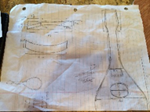
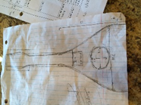
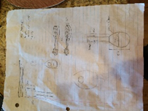
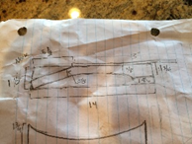
Building a Mandolin
Anna Guarino
Product Goal:
The goal of this project is to build a functional mandolin. I would like it to look somewhat like a “real” mandolin. It will be significantly less fancy than a professional mandolin, but it will be able to play notes in tune. It will be made of fairly inexpensive materials that will still fulfill the same requirements as a professional mandolin’s materials: strong wood for the neck, flexible wood for the sides, etc.

Slide 2
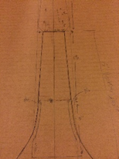
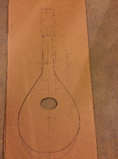
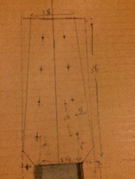
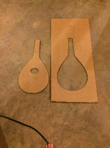
Background Research:
A mandolin is a tear drop shaped string instrument with eight strings grouped in four pairs of two. It can have a bowl shaped back or a flat front and back. It is usually around twenty seven inches long. I used some general measurements (the length, width, and depth) from a website, and I also used mandolin blueprints that were more specific. I figured out that there is no exact way to build a mandolin; measurements, strings, types of wood, and details can vary. For example, the f-type mandolin has a fancy curlicue, while the a-type, the type I am building, is just the basic teardrop. To make the teardrop shape, the sides of the mandolin are bent strips of wood. The thinner the wood used, such as a thin plywood, the easier it is to bend.
Besides the wood, a mandolin’s sound is also affected by the length, thickness, and tightness of its strings. The longer, looser and thicker the strings, the lower the notes and deeper the tone. The shorter, tighter, and thinner the strings, the higher the notes and shriller the tone. Depending on where your fingers press the strings on the fret board, they change the vibrating length of the strings, which changes the notes. The strings are tuned with the pegs on the peg board; there are four pegs on each side of the board. Because the strings are in pairs, each string in a pair is tuned to the same note.
The type of wood used does affect the tone of the instrument; finer woods give a better sound. Those woods, such as mahogany and Indian rosewood, are also really expensive. Oak and maple from the hardware store can work just fine. Hardwoods are crucial, especially for the neck, because they resist bending. Obviously, all the wood has to be relatively durable because no one wants a giant hole busted into the back of their mandolin.

Slide 3
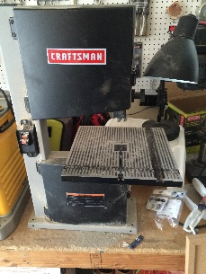
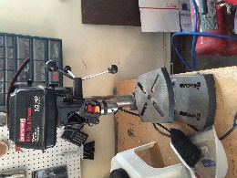
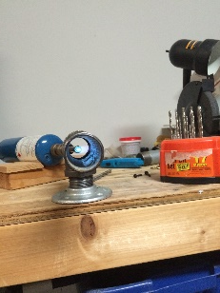
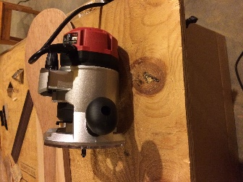
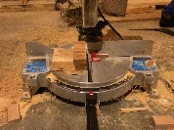
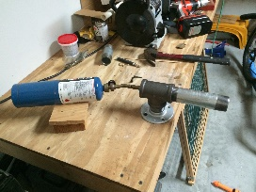
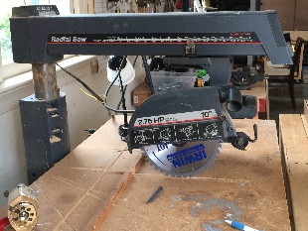
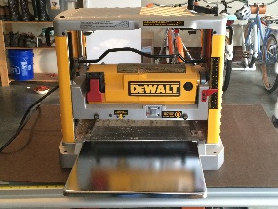
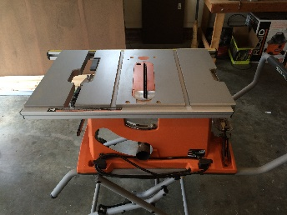
Materials:
-sharp pencil
-ruler
-wood glue
-large piece of cardboard (about 1.5ft by 3ft)
-knife to cut cardboard
-lauan plywood (3/16 in x 2ft x 4ft)
-3 kiln dried oak/red oak boards (¾in x 2½in x 48in)
-table saw
-ban saw
-jig saw
-planer saw
-radial arm saw
-compound mite saw
-wood sander
-sandpaper
-plywood for bending jig
-handheld saw
-large plastic basin (about 2ft by 2ft)
-metal pipe
-blowtorch
-6 clamps
-8 tuning pegs
-8 mandolin strings
-plastic slotted mandolin nut
-mandolin tailpiece
-mandolin bridge
-fret board
-fret wire
-iPhone for mandolin tuning app or just a tuner
-pieces of scrap wood in various sizes just in case... once some cuts are made, there is plenty

Slide 4
Design Process:
I went online and found mandolin blueprints, and I made some basic sketches with modified measurements.
I took out a pencil and the cardboard, and I drew a to-scale front view of the mandolin. I used my research and the blueprints for reference. For side views, I sketched on paper. The neck is a total of 14 in long, and at the base, it is 2 ¾ in wide and 1 ¾ in deep. There is a groove 3 in up each side of the neck’s base for the sides of the mandolin to fit into. The neck then tapers for 5 ½ in to 1 ⁹/₁₆ in wide. The neck tapers all the way up until the pegboard to 5/8 in thick. This is where the 5 ½ in long pegboard starts. It gets wider to 2 ¾ in and then tapers again to 1 ¾ in. The pegboard is 5/8 in deep, and it slants downwards from the neck. The body is 1 ¾ in deep and 10 ½ in wide at its widest. It is 13 in long starting from where the sides connect with the neck down to the bottom. The top piece overlaps the neck all the way to the base of the pegboard. The bottom piece only overlaps at the base of the neck. The sides are 3/16 in thick and they bend to make the teardrop shape. 5 ½ in up from the base of the body is the bridge, and 1 5/16 in up from there is the sound hole. The sound hole is 2 in tall and 3 in wide.
Using a knife, I cut out the cardboard front view, not including the pegboard, and traced it on the maple plywood twice: once for the front piece and once for the back. I also traced the shape on a scrap piece of plywood that was much thicker than the maple. Once the shape was cut out, it would be used as a bending jig to hold the shape of the bent sides.
I took out the 3 pieces of oak hardwood and stacked them together. My dad glued them together and clamped them. I made a mark at 14 in for my dad to cut at. I drew the neck measurements on all the sides of the piece after it was cut. We would need a different saw to do the more difficult cuts.
We had to go to my dad’s friend’s house to use fancier saws. Using a planer saw, we were able to shave off the rough edges of the neck block. It also shaved off some of the measurements I had drawn on the wood, so I redid them.
My dad used a ban saw to make all the complicated neck cuts. This was the one power tool that I couldn’t really help with.
We sanded the neck to make it smoother with his friend’s special sander.
My dad and his friend used the table saw to cut two strips of wood for the sides from the long edge of the maple plywood. I stood on the other side and caught the wood.
Using a jig saw while I held the wood still, my dad cut out the shape from the plywood for the bending jig, and he cut out the top and bottom pieces for the mandolin. He cut those a little too large so we could trim them to fit the sides later with a router.
My dad drilled four holes going down the left side of the front of the peg board. Then he drilled four holes on the right. These holes would hold the tuning pegs.
We went home to bend the side pieces. We filled up a long plastic rectangular bin with about 7 gallons of lukewarm water, using a bucket to pour the water in. I would move one of the pieces of wood back and forth in the water, soaking it and bending it slightly.
I would hand the wood to my dad, who would bend it around our version of a bending iron (a blowtorch with a metal pipe over it), which was attached to a table in our garage. The heat and moisture combined made the wood bend.
Once the wood was bent enough, we forced it into the shape of the bending jig and used the four clamps to clamp it into the right shape. It dried there overnight.
During the bending process, the wood snapped at the base, so I glued a leftover block of oak wood (2in x 3in x 1¾in) that was sanded to fit the inner curve of the mandolin’s base. It would add stability and serve as a place for the tailpiece to screw into.
My dad cut the excess off the ends of the sides using a compound mite saw to fit into the neck while I held the wood still. Then I sanded the neck for a somewhat perfect fit, and I glued and clamped the sides and neck together.
My dad trimmed some of the excess off the bottom piece with the compound mite saw so that it would fit the base of the neck. Again, I held the wood still.
My dad cut the bending jig so that the neck of the mandolin could jut out. We forced the sides into the bending jig and shoved bits of scrap wood between the sides and the edge of the bending jig to make the shape more symmetrical.
I placed the bottom piece face down and put glue on the edge of the sides and base of the neck. Then my dad laid the sides and neck (still in the bending jig) on top of the...

Slide 5
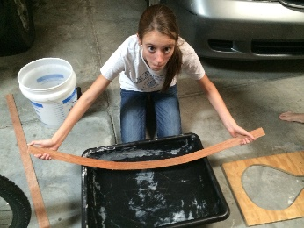
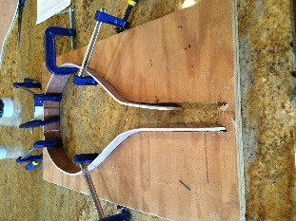
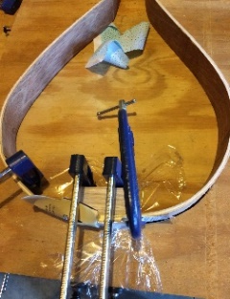
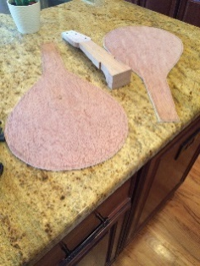
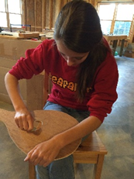
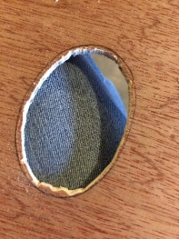
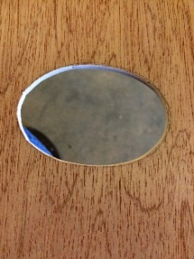
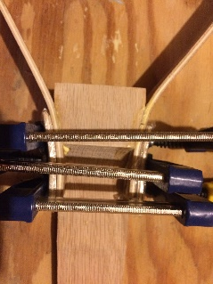
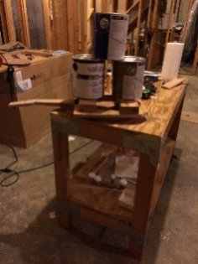
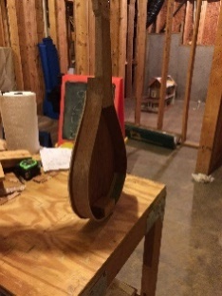
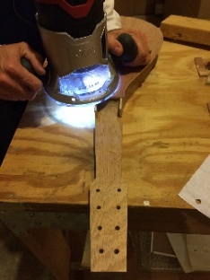
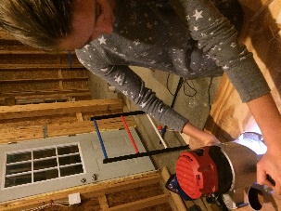
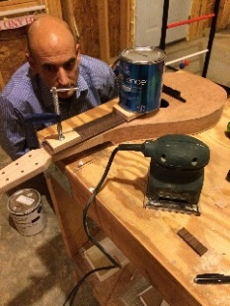
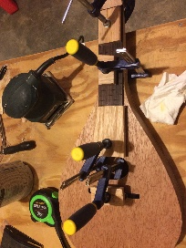
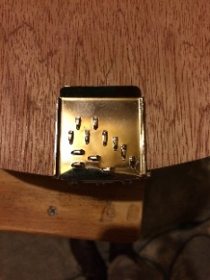
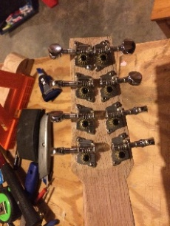
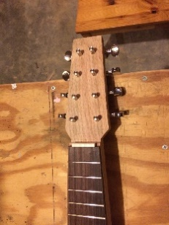
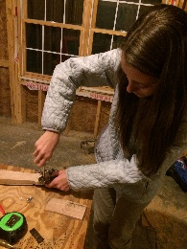
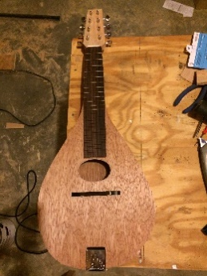
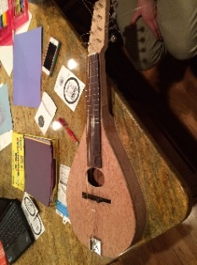
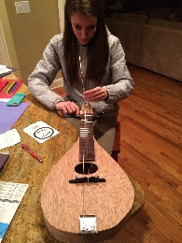
More Design Process:
... bottom piece. I told him how to position it so that there would be enough wood in all places. I put wood blocks on top of the sides and then put paint buckets on top of the wood blocks. This weight pressed the sides on the bottom piece to glue them tightly.
When it was dry, my dad used a router to trim any excess wood off the bottom piece to fit the sides.
The same process I used to glue the bottom piece was used to glue the top piece. However, the top piece extends all the way up the neck to the base of the pegboard. My dad routed it when it was dry. I glued a small piece of wood above the top piece; the neck didn’t reach up far enough.
My dad trimmed the bottom of the fret board so that it didn’t extend into the sound hole. I glued the fret board on top of the neck, clamped it, and let it dry. My dad routed the excess after it was done drying. Once it had dried, I trimmed the fret wire to fit into the slots and my dad hammered them in.
I glued on the bridge below the sound hole but above the base of the mandolin. I positioned the tailpiece so that it was centered and let my dad bend the metal to fit the bottom and screw it in. Then we attached the pegs into the holes of the pegboard.
I attached the strings one by one. I would hook a string to its notch on the tailpiece and stretch it up over the bridge and through the hole in its corresponding peg. Then I wrapped the string around the peg and turned the twisting part of the tuning peg counter clockwise to tighten the string. Once all the strings were finished, I cut off the excess.
I used a tuning app on my phone to tune the strings. I tuned each of the four pairs of strings to a particular note; the two thickest strings were tuned to a G, the second thickest pair was tuned to a D, the next thinnest pair of strings was tuned to an A, and the very thinnest strings were tuned to an E. To make a note sharper, I tightened the string, and to make it flatter, I would loosen the string. I adjusted the strings by turning the tuning pegs.

Slide 6
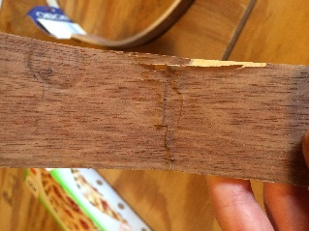
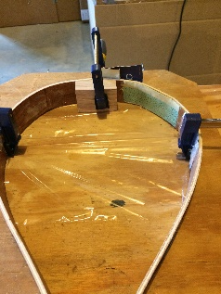
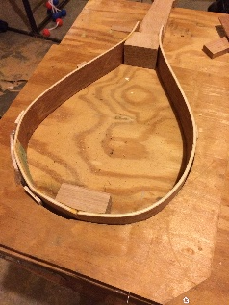
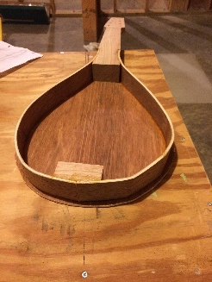
Evaluation:
Building the mandolin was not easy at all. Each step ended up taking about 30 minutes longer than I had originally hoped. Making the measurements was fairly simple because I had the blueprints to base them off of, but I did modify many of the blueprints’ measurements to make it my own mandolin and to simplify somewhat. When I drew out the measurements for the hole in the bending jig on the wood, they weren’t quite symmetrical, so the sides came out asymmetrical after bending.
During the bending, the wood snapped at the base because the curve was too harsh for the plywood to handle. Because plywood is layers of wood compressed together, the layers peeled and snapped in the bending, starting with the layer on the outside of the curve. Professional mandolins use one very thin layer of wood for the top, bottom, and sides for this reason. My plywood was the thinnest that I could find, but it was still too thick to bend very much without snapping. I put the sides into the bending jig even though they’d snapped, and glued them together later and stabilized them with a base piece on the inner curve of the snapping point. Luckily, the wood snapped where the base would be, so the wooden piece inside the base of the mandolin would have already been there to screw the tailpiece into anyway.
Some places on the curves of the sides, especially on the inside, were peeling, especially in one particular area. I didn’t want the peeling to spread, so I glued a polka dotted piece of scrap fabric from my sewing box overtop of the peeling spot inside the mandolin. I made sure there was a thick enough layer of glue on top of the fabric so that it wouldn’t absorb any of the sound; the sound would still bounce off as it was supposed to.
To fix some of the asymmetry of the sides, I shoved thin scrap plywood pieces between the bending jig and the sides. This would push the curves inwards in some places to make them less harsh and force them to be harsher in other places. Then I glued the bottom piece on so that when the sides came out of the bending jig glued to the bottom piece, they would hold the desired shape. They ended coming out almost perfect; they were as close to perfect as they were going to get.
When we glued the neck into the sides, the way it fit with the sides made the neck come out of the instrument farther than I had intended. Therefore, since the top piece extended all the way up the neck, it came up a bit short. I glued a small piece of wood right above the top of the top piece to fill up the empty space. It would also prop up the slotted nut later.
Once the top piece was long enough, I glued on the fret board, which was hard to clamp because it kept sliding around. It ended up being slightly off center, but not noticeably to anyone who hadn’t built it. Then my dad hammered in the fret wire; I would have done it, but it needed much more force than I expected to get the fret wire to stay in the slots. It became somewhat like Whack-a-mole; as soon as one of them finally stayed hammered in, another wire popped up. Eventually they all stayed. We didn’t buy enough fret wire to trim and hammer in a piece for all the slots in the fret board, and we didn’t have enough time to buy more. I decided to be satisfied with the fret wire that I had since it wasn’t crucial to the mandolin making a sound.
Every other step went fine; the cuts my dad made for the different pieces were somewhat rough, but they were very complicated cuts to make, especially all the edges and angles of the neck. I went back later and sanded where I needed to. The bottom of the neck should really be much smoother and rounded than it is, but again, that is not crucial to the sound, so I have decided to fix that later. The routing was fun for me; it was easy and the router made really smooth, accurate cuts. It was the one saw that I actually got to use! The others generally required past experience, at least for the cuts I needed to make.
Putting on the strings was easy once I got the hang of it; at first it seemed complicated because there was a lot of twisting the strings around the pegs and making sure they didn’t slip. Tuning was also simple and I didn’t encounter any problems.
A “real” mandolin can cost anywhere from hundreds to thousands of dollars. My mandolin cost around $30 for wood and $45 for strings, fret wire, a fret board, a nut, and a bridge. The tuning pegs were free; my piano teacher happened to have exactly 8 pegs lying around in his studio. So overall, it’s worth about $75.

Slide 7
Conclusion:
The finished mandolin met my design goals well. I wanted my mandolin to resemble a real mandolin at least somewhat and play notes in tune. It has reached both of those goals. However, it was not easy; there were some challenges along the way.
The most difficult challenge was definitely bending the wood for the sides. The wood snapped during the bending, but we were able to glue it back together. Because my bending jig was asymmetrical, the sides did not come out with quite the same curve on either side. By shoving bits of scrap wood into the bending jig, I was able to fix that significantly. By putting glue and some scrap fabric on the peeling areas of the wood, I was able to stop the peeling from spreading. The sides gave the most difficulty, but nothing impossible to fix.
Before I had started researching this project, I had no idea how to work with wood. I definitely had some unrealistic ideas! I saw pictures of mandolins with bowl shaped backs, and I thought I could carve the bowl shape out of a giant block of wood. I was very naïve. I had imagined fancy f-shaped sound holes and a smooth, shiny finish; I thought, at first, that I could make a professional looking mandolin: no problem. Once I started researching, I realized that I was extremely wrong; every step is so much more complicated than I had anticipated. My finished mandolin has a flat back, an oval sound hole, and rough, almost peeling sides. It is nowhere near perfect, but since neither my dad or I had any experience whatsoever with string instruments, it turned out pretty well! Later, I would like to put slots in the bridge to keep the strings more spread out, lower the bridge and raise the nut to level out the strings, and put a finish on the wood.
From building a mandolin, I was able to learn much more about woodworking. I know how eleven different power tools work: a drill, a handheld power saw, a blowtorch, a sander, a ban saw, a radial arm saw, a jig saw, a planer saw, a compound mite saw, a table saw, a drill press, and a router. I know how to bend wood, and I know that I would never like to attempt that task ever again. I appreciate the work that goes into making instruments (or really anything made of wood) much more now. I am going to apply what I learned from this project into helping make a set for the Peter Pan play in drama.

